Slide 1
Q of the Day
1. What does resiliency mean?
2. What is one goal you want to accomplish in the next year? How about the next five years? 10 years?

Slide 2
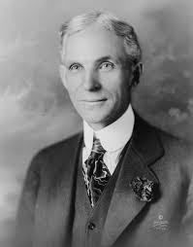
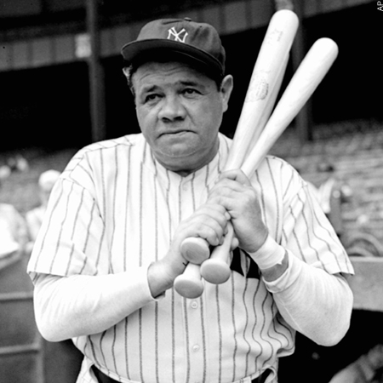
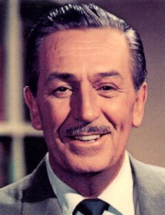
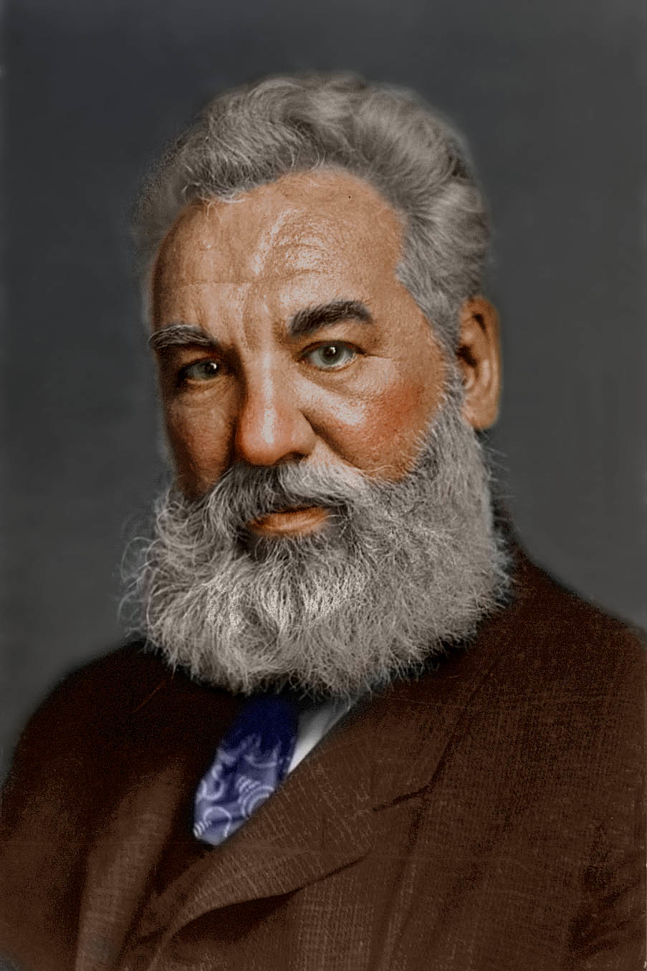
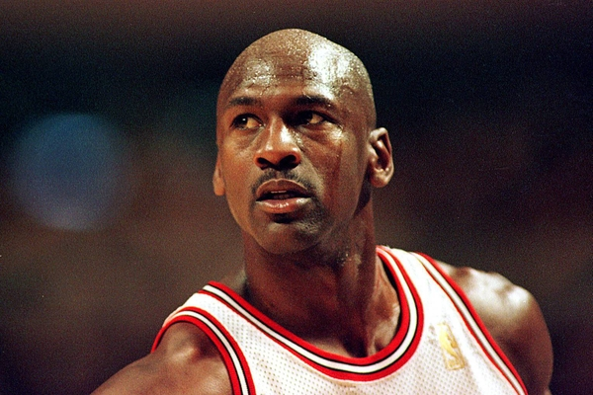
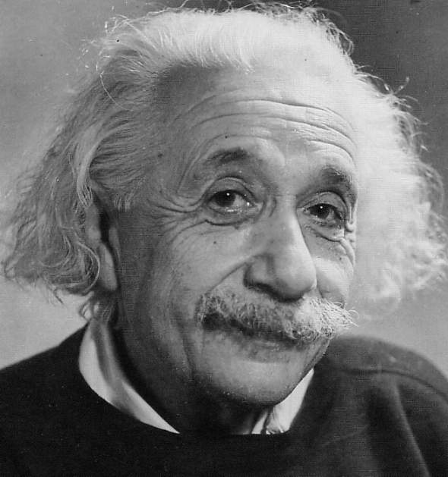
Success or Failure?

Slide 3
Goal Setting

Slide 4
Long-term Goal
A long-term goal is a goal that you plan to reach over an extended period of time.
Example?

Slide 5
Short-term Goal
A goal that you can achieve in a short length of time.
Example?
To achieve your long-term goals, you must set a few short-term goals.

Slide 6
SMART GOALS
Specific
Measurable
Attainable
Relevant
Timed

Slide 7
Strategies for Attaining a Goal

Slide 8
1: Set a realistic goal and write it down
Example: "I'm going to recycle all my plastic bottles, soda cans, and magazines" is a much more doable goal than "I'm going to do more for the environment.”
WRITE IT DOWN!

Slide 9
2: List the steps you need to take to reach that goal & make it a routine
It will probably take a couple of months before any changes — like getting up half an hour early to exercise — become a routine part of your life. That's because your brain needs time to get used to the idea that this new thing you're doing is part of your regular routine.

Slide 10
3: Find others who can help and support you
When we tell someone else about our goal we are now accountable, and therefore more likely to follow through.
The key to making any change is to find the desire within yourself — you have to do it because you want it, not because a girlfriend, boyfriend, coach, parent, or someone else wants you to.

Slide 11
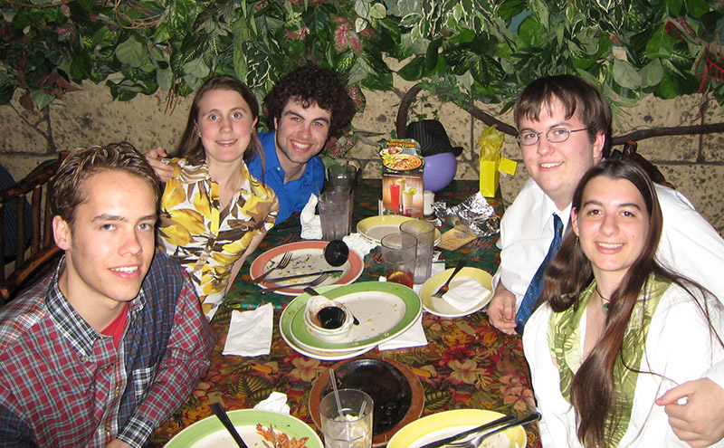
4: Reward yourself after reaching your goal
Think of a reward so you have something to look forward to when you reach your goal.

Slide 12
Reminder: Roadblocks Don’t Mean Failures
Slip-ups are actually part of the learning process as you retrain your brain into a new way of thinking. It may take a few tries to reach a goal.

Slide 13
Lindsey on AGT

Slide 14
Michael Phelps Video
http://kidshealth.org/teen/school_jobs/school/goals_tips.html\
Pay attention to Michael’s reason for writing down his goals.

